Slide 1

United States Employment Data Analysis
By:
By: Mrudula M
& Yewande Taiwo

Slide 2
Case Study: USA Employment Data
Quandl is the main source for the data.
Our aim for the project is to explore USA Employment data.
Dataset is US Employment data
From 1985-2006
Taken on the last day of each year
Looking at the labour force participation rate - people employed and those actively looking for work.
Data is Quantitative type and is Continuous in nature.
Future scope: Extending analysis to multiple countries and working on future projections.

Slide 3
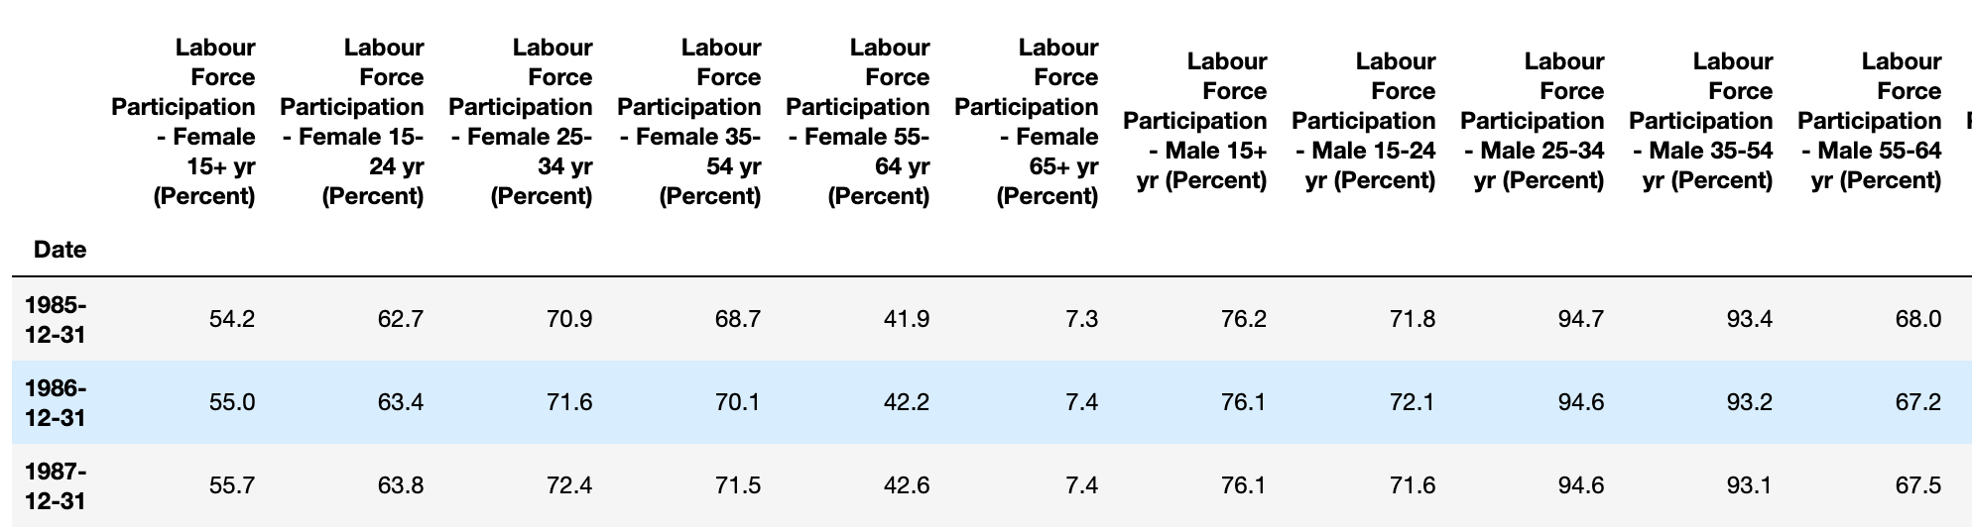
Setup:
Import data from quandl.
Convert to dataframe.
Numpy functions are used to understand data.
Check for nulls in the data and unwanted data is dropped.

Slide 4
Statistical Analysis:
For both male and female the mean and median are increasing from age 15+ till 54 yrs, later it is decreasing.
Mean percentage change from 15-24 yrs to 24-35 yrs is around 13 percent for female data whereas for male this is around 26 percent.
It is observed that data has more that one mode, some has up to 5.
IQR which shows the middle 50% of the data has been calculated.
To check the impact of single variable on data, Univariate analysis is done on Female 15+ and Male 15+ data.
Used Histogram and box plot to understand the five point summary of the data, skewness and check for outliers is done.

Slide 5
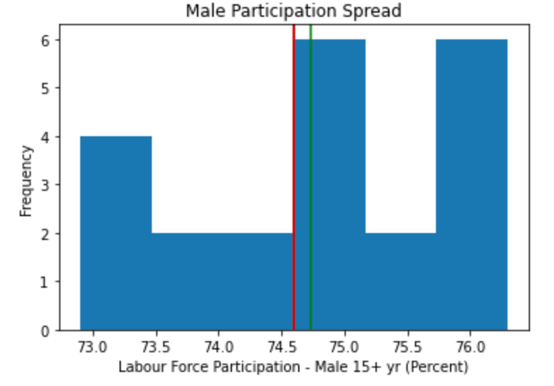
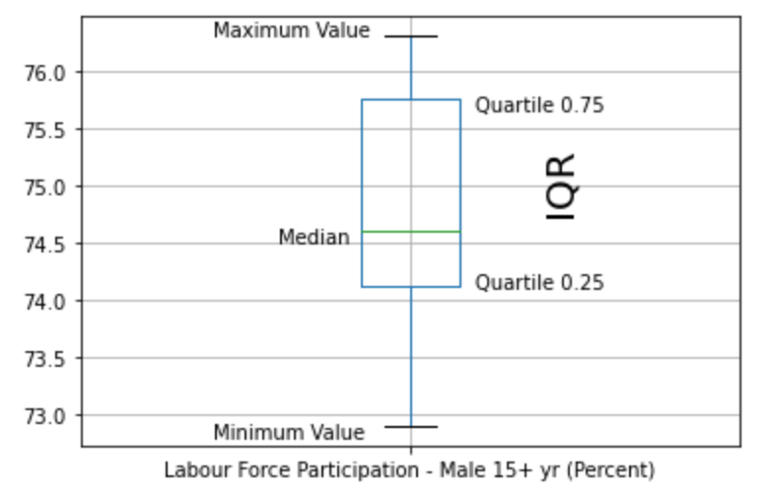
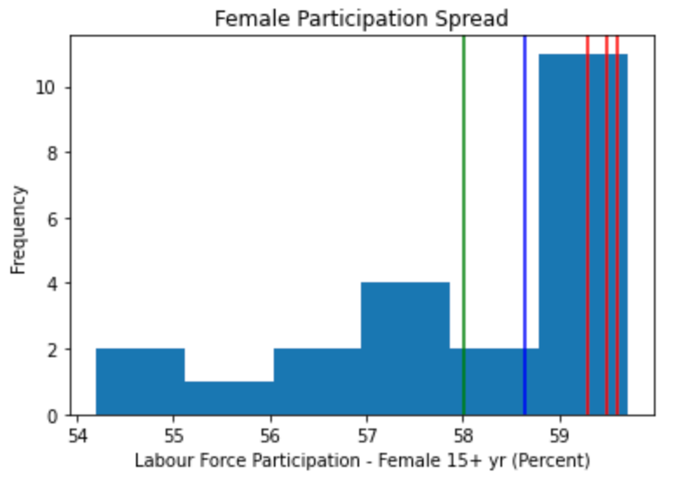
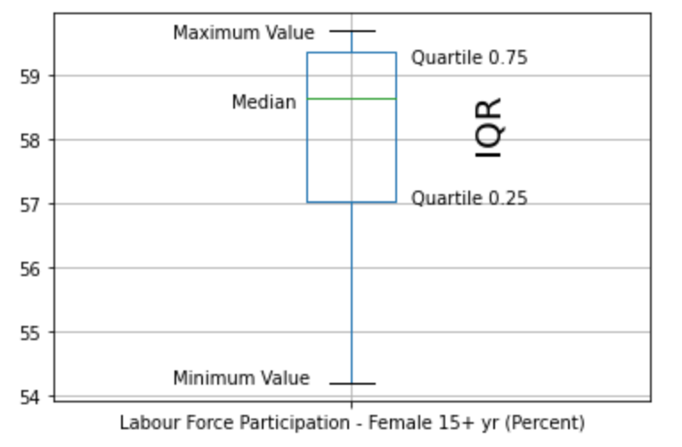
Statistical Analysis contd..:
Data is slightly right skewed for Male labour participation.
No outliers observed.
Data is left skewed for Female labour participation.
No outliers observed

Slide 6
Questions about data:
Question 1.
What is the behaviour of labour participation rate over time between males and females?
Question 2:
How are the female and male labour participation rate changing over age and over time?
Question 3:
What is the comparison between labour force participation for male and female for each age group?
Question 4:
Does increasing female labour participation rate have any effect on male participation rate?

Slide 7
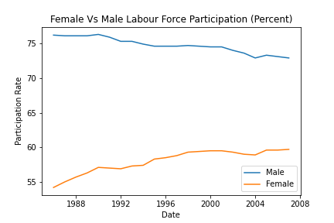
What is the behaviour of labour force participation over time between males and females?
There is a huge gap between availability of Male and Female workforce.
Male work force participation rate is decreasing where as the female workforce is increasing over the years.
Due to some unknown condition there is decline in both workforce especially at 2004.

Slide 8
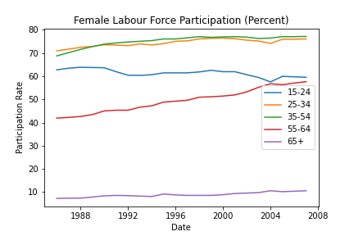
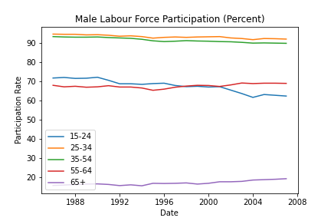
How are the female and male labour force participation changing over age and over time?
65+ age category has less participate rate among all.
Over the age from 25 to 54 participate rate is mostly going at the same rate.
Surprisingly, 15-24 age workforce has decreased over the years.
55-64 age group is increasing at a steady rate.

Slide 9
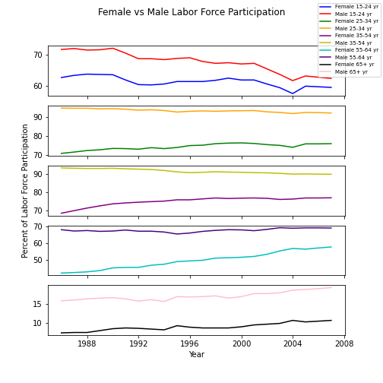
What is the comparison between labour force participation for male and female for each age group?
In 2004, there is a sharp drop in employment in the 15-24 age range in both male and female. Drop is seen less so in other age groups.
The gap in labour force participation between male and female is getting closer to each other, except in the 65+ age range.

Slide 10
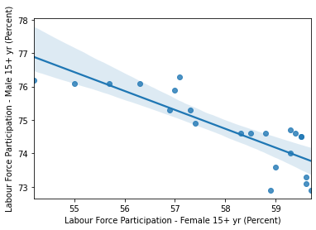
Does increasing female labour force participation have any effect on male participation rate?
Correlation value = -0.84
A negative correlation between female and male labour participation rates.
Strong correlation between female labour force participation and male.
As more women start working, there’s a decrease in male labour force participation.

Slide 11
Thank You

